Slide 1
Apigee Platform setup

Slide 2

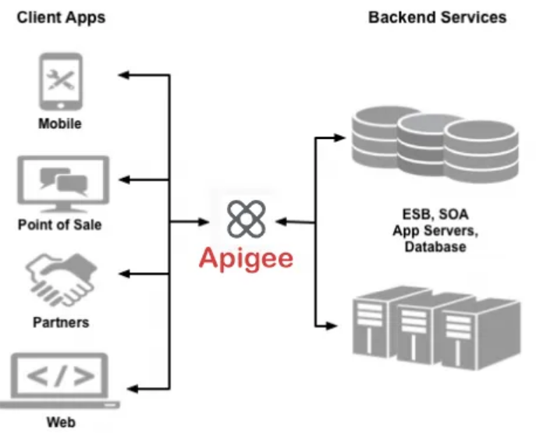
Introduction:
Apigee is a platform for developing and managing APIs. By fronting services with a proxy layer, Apigee provides an abstraction or facade for your backend service APIs and provides security, rate limiting, quotas, analytics, and more.
Apigee enables you to provide secure access to your services with a well-defined API that is consistent across all of your services, regardless of service implementation.
A consistent API –
  Makes it easy for app developers to consume your services.
  Enables you to change the backend service implementation without affecting the public API.
  Enables you to take advantage of the analytics, developer portal, and other features built into Apigee.
Rather than having app developers consume your services directly, they access an API proxy created on Apigee. The API proxy functions as a mapping of a publicly available HTTP endpoint to your backend service. By creating an API proxy you let Apigee handle the security and authorization tasks required to protect your services, as well as to analyze and monitor those services.
Apigee X is the latest variant released by Google. Like Apigee Edge, in Apigee X, both the management plane and the runtime are managed by GCP (Google Cloud Platform). The Apigee runtime resides in your VPC Network, and a GCP HTTP(s) Load Balancer serves as the entry point into Apigee.

Slide 3


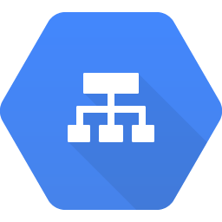
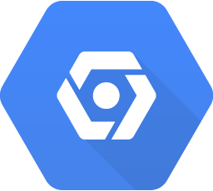
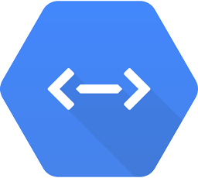



Apigee X: Network Deployment Topology
API Consumer
(Internet)
Client Google Project
Apigee X Google Project
Cloud Armor
Apigee X Runtime
Instance
Load Balancer
PSC-NEG
PSC (Northbound)
Service Attachment
Apigee Runtime
HTTPS + Oauth
Internet
On Premises
Cloud VPN/ Interconnect
Backend Service
Service Attachment
PSC (Southbound)
PSC-NEG
API Consumer (Internet)
BCBST VPC
Google VPC
Client VPC needs to allow ingress traffic from internet to access APIs hosted by BCBST’s Apigee X instance
Client VPC needs to have connectivity to on-prem network to allow Apigee X to access Backend Services that it is proxies
Client VPC needs to implement network security measures in alignment with Enterprise Security Standards
Notes:
Notes: Using Terraform (Infrastructure as Code) It is the process of managing and provisioning the complete IT infrastructure (comprises both physical and virtual machines) using machine-readable definition files. It helps in automating the complete data center by using programming scripts and can be embedded to Dev-Ops We always recommend to use automation to Infrastructure as code using (Terraform as an example).

Slide 4
Apigee X: Platform Architecture with PSC (Northbound)
Internet (HTTPS) -> Load Balancer -> PSC NEG -> Service Attachment -> Apigee X (HTTPS)
Key points
VPC containing the PSC NEG does not need to be peered to the Google VPC.
PSC NEG can be used with either TCP (L4) or HTTPS (L7) LB.
NAT is handled by PSC.
PSC service attachment in the Google-Managed Apigee X Tenant project is created at instance creation time.
Private Service Connect Network Endpoint Group (PSC NEG) in the same region as the runtime.
API Consumer
(Internet)
Client Google Project
(Non-peered)
Apigee X Google Project
Cloud Armor
PSC-NEG
PSC (Northbound)
Service Attachment
Apigee Runtime
Region 1
Apigee X Runtime
Instance
HTTPS + OAuth
Load Balancer
PSC-NEG
PSC (Northbound)
Service Attachment
Apigee Runtime
Region 2
Apigee X Runtime
Instance
API Consumer (Internet)
Client VPC
Google VPC

Slide 5

Apigee X: Platform Architecture with PSC (Northbound)
On Premise (HTTPS) -> Cloud VPN/Interconnect -> Load Balancer -> PSC NEG -> Service Attachment -> Apigee X (HTTPS)
Key points
Connection from on-premises to GCP via Interconnect/VPN
VPC containing the PSC NEG does not need to be peered to the Google VPC.
PSC NEG can be used with either TCP (L4) or HTTPS (L7) LB.
NAT is handled by PSC.
PSC service attachment in the Google-Managed Apigee X Tenant project is created at instance creation time.
Private Service Connect Network Endpoint Group (PSC NEG) in the same region as the runtime.
API Consumer
(On Premises)
Client Apigee Google Project
(Non-peered)
Apigee X Google Project
Service
PSC-NEG
PSC (Northbound)
Service Attachment
Apigee Runtime
Cloud Armor
HTTPS + OAuth
Region 1
Apigee X Runtime
Instance
Service
Cloud VPN/ Interconnect
Load Balancer
Service
PSC-NEG
PSC (Northbound)
Service Attachment
Apigee Runtime
Region 2
Apigee X Runtime
Instance
API Consumer (On Premises)
Client VPC
Google VPC

Slide 6


Apigee X: Platform Architecture with PSC (Southbound)
Apigee X (HTTPS) -> Service Attachment -> Load Balancer -> Cloud VPN/Interconnect -> On-prem LB (HTTPS) -> Backend (HTTPS)
Key points
Connection to on-premises Google project via Interconnect/VPN
Client VPC does not need to be peered to the Google tenant VPC
One Endpoint Attachment per Service Attachment.
Service attachment can attach to one of TCP (L4) or HTTPS (L7) LB.
Apigee X Google Project
Client Google Project
(Non-peered)
On Premises
Backend Service
Apigee Runtime
Endpoint Attachment
PSC (Southbound)
Service Attachment
Apigee X Runtime
Instance
Region 1
Cloud VPN/ Interconnect
Backend Service
Load Balancer
PSC (Southbound)
Backend Service
Apigee Runtime
Endpoint Attachment
Service Attachment
Apigee X Runtime
Instance
Region 2
Google VPC
Client VPC
On Premises

Slide 7
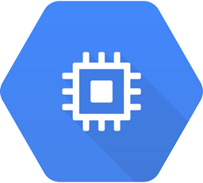
Apigee X: Platform Architecture with PSC (Southbound)
Apigee X (HTTPS) -> Service Attachment -> Load Balancer -> GCP Backend Service (HTTPS)
Key points
Client VPC does not need to be peered to the Google VPC
One Endpoint Attachment per Service Attachment.
PSC service attachment in the VPC network where the target services are deployed.
NAT is handled by PSC.
Service attachment can attach to one of TCP (L4) or HTTPS (L7) LB.
Apigee X Google Project
Client Google Project
(Non-peered)
Apigee Runtime
Endpoint Attachment
PSC (Southbound)
Service Attachment
Apigee X Runtime
Instance
Instance Group
Region 1
Load balancer
Serving Instance
Compute Engine
Multiple Instances
Apigee Runtime
Endpoint Attachment
PSC (Southbound)
Service Attachment
Apigee X Runtime
Instance
Region 2
Google VPC
Client VPC

Slide 8
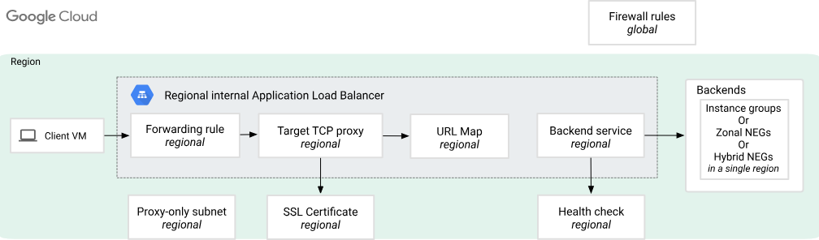
Apigee X: Platform Architecture with PSC (Northbound internal load balancer)

Slide 9
Private Service Connect (PSC)
Fully managed simplified solutions which empowers to publish services within dedicated VPC networks.
Published services are then accessed privately and securely from the consumer’s VPC network.
Eliminates the need for tasks like VPC peering, routing table modifications, IP address configurations, and NAT rule implementations.
Service-oriented connectivity (Vs network-oriented connectivity).
keeps all traffic confined within Google’s backbone.
.
Notes:
Notes: Using Terraform (Infrastructure as Code) It is the process of managing and provisioning the complete IT infrastructure (comprises both physical and virtual machines) using machine-readable definition files. It helps in automating the complete data center by using programming scripts and can be embedded to Dev-Ops We always recommend to use automation to Infrastructure as code using (Terraform as an example).

